Slide 1
Patient satisfaction among children with unilateral lower limb prosthesis, comparing Norway and Cambodia
Gunhild Aasen
Rune Nilsen
Comparing children with prosthesis
Quality of life and satisfaction with their prosthesis
2 qualitative questions regarding game and play activities

Slide 2
Hypothesis
Children with prosthesis in Norway has a higher quality of life than children with prosthesis in Cambodia
Children in the two countries have different games and play activities

Slide 3

Background info
Norway is one of the richest countries in the world, number 5 with BNP of 59300 USD per capita
Cambodia is one of the poorest countries in South East Asia, BNP 2000 USD per capita

Slide 4
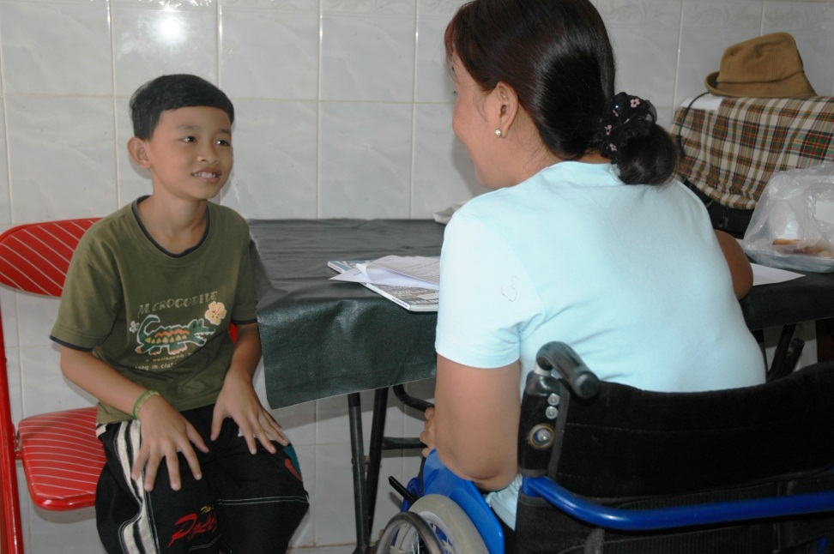
Method
Peds-ql is a quality of life questionaire aimed at children with disabilities
Validated in many languages, including Khmer(we did that) and Norwegian
Questionaire about prosthetic satisfaction
2 qualitative questions about play and game activities
Ethical Committee application and approval

Slide 5
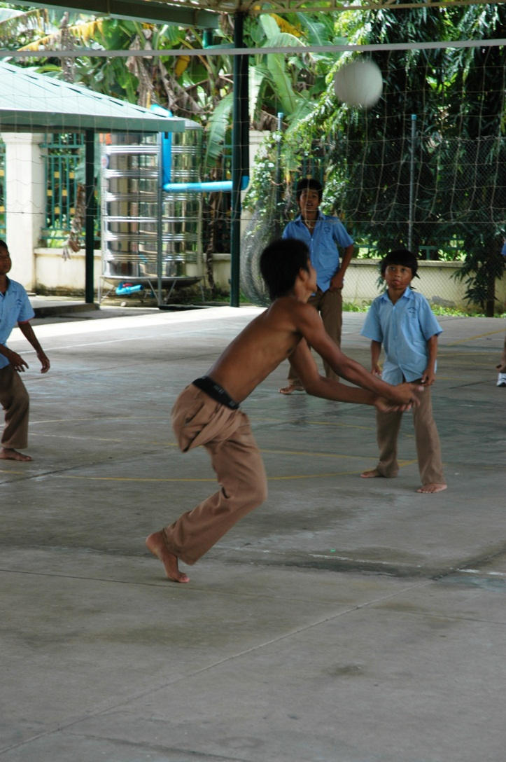
Criterias
Children with one lower limb prosthesis and no other disabilities
No mental disorders
Age between 8 and 12

Slide 6
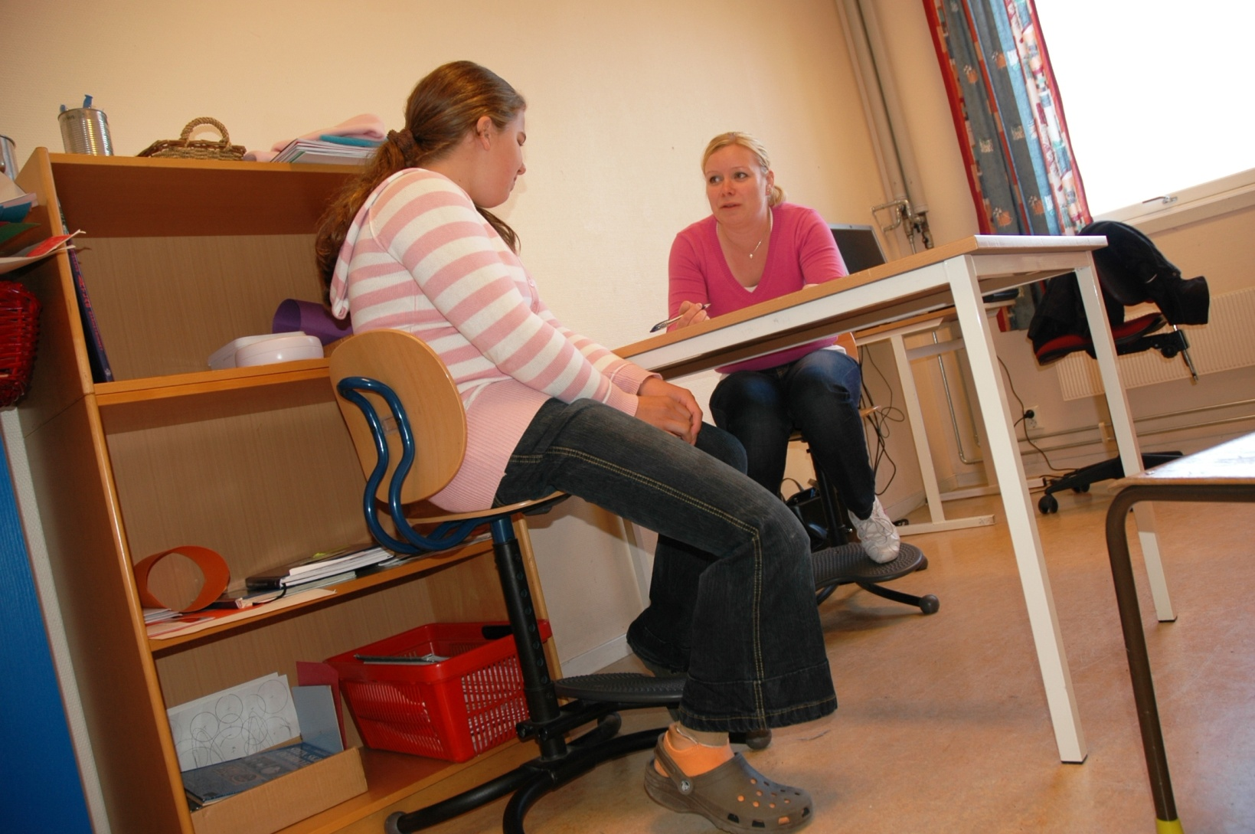
Method in Norway
9 children fulfill all criterias
Interviews in clinic, at school or at home
Prosthetist who make prosthesis not to perform interview
Parents not present during questionaire session

Slide 7
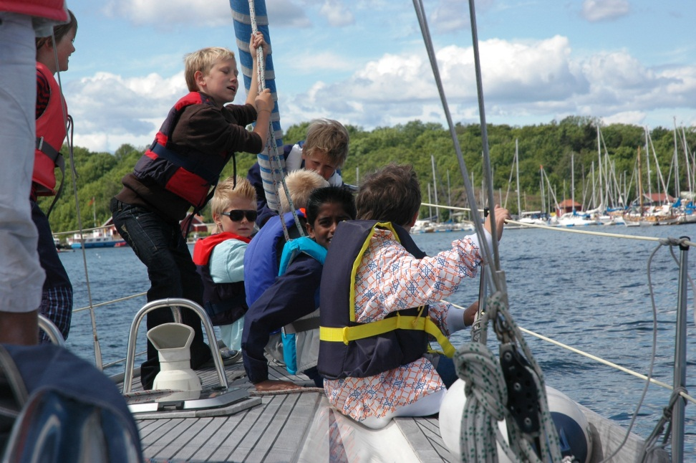
Method in Norway
Group of 22 non disabled children
Reference group for comparing results

Slide 8
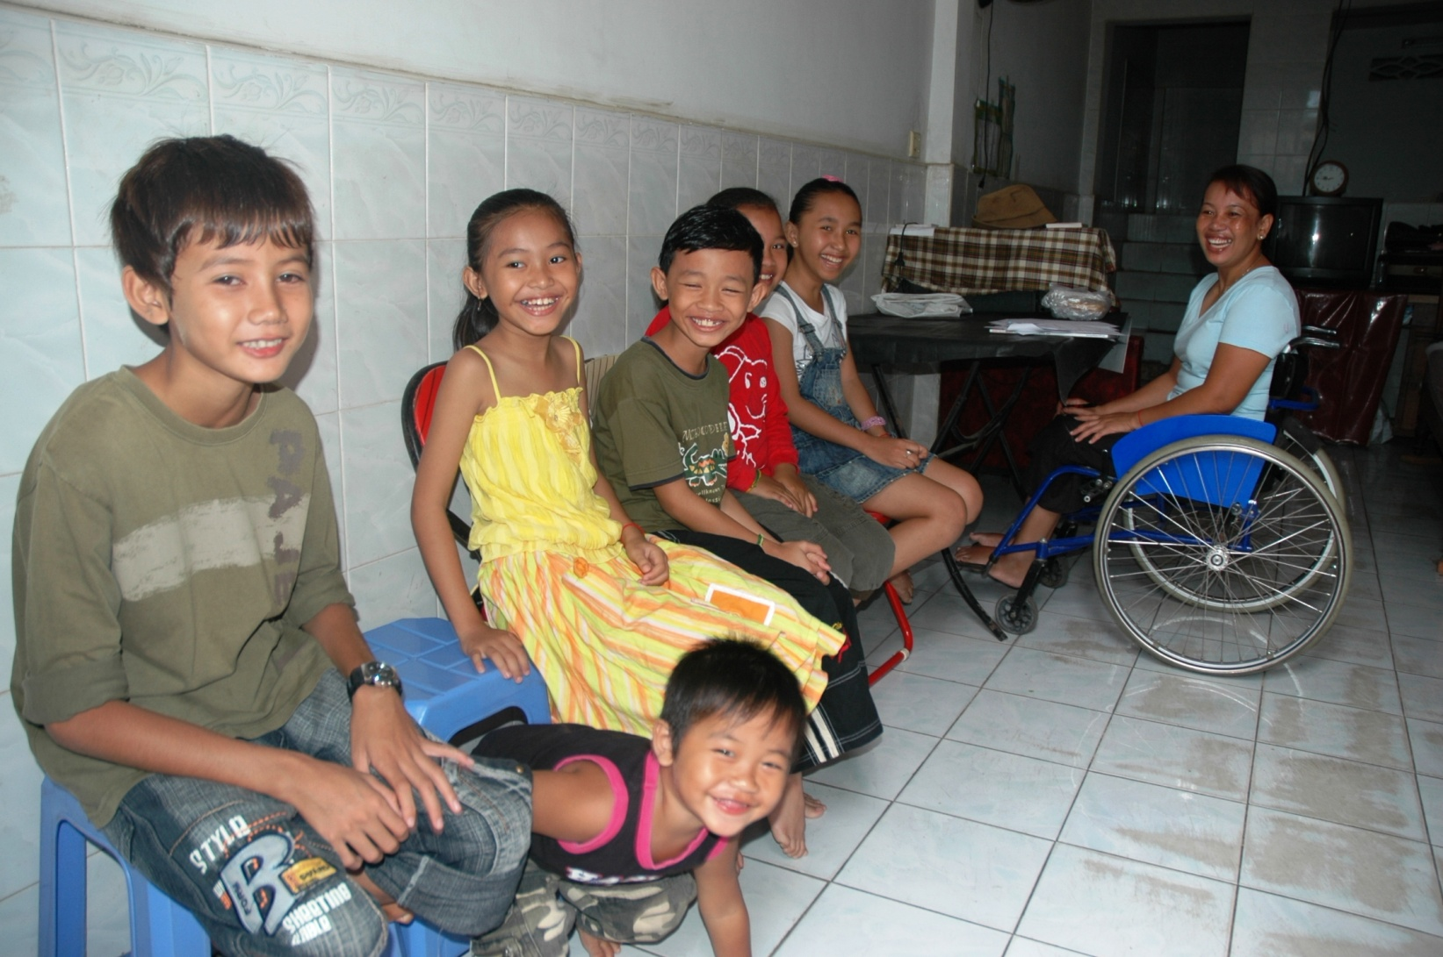
Method in Cambodia
Translation into Khmer and back two times
Tested on 10 non disabled children
Performed by Khmer interpreter
Parents not present

Slide 9
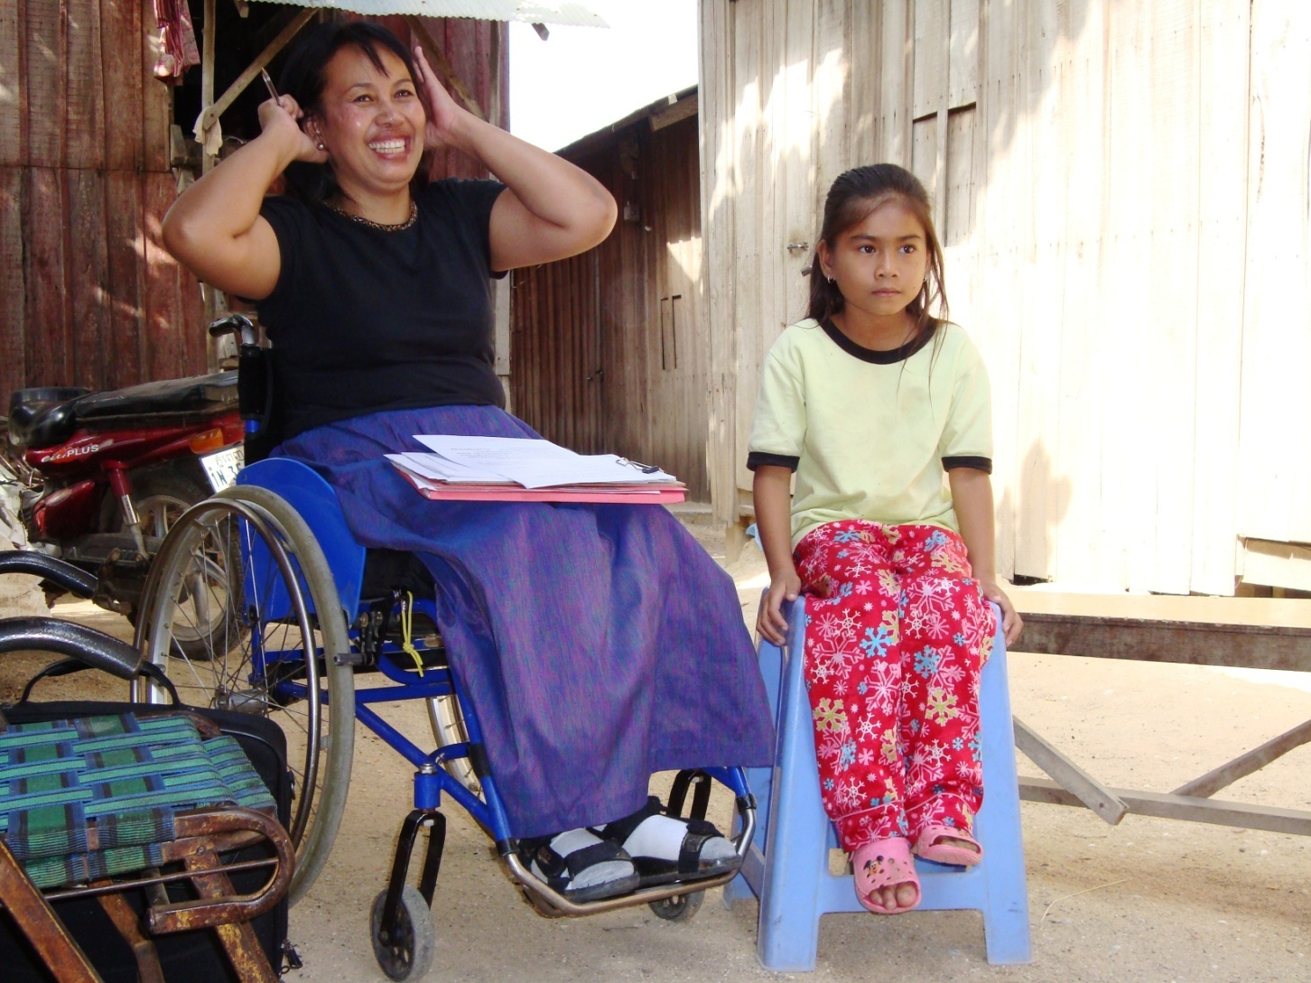
Method in Cambodia
Interviewed 19 children with unilateral prosthesis
3 visits
Rural and urban
Performed by the same interpreter
Parents not present

Slide 10
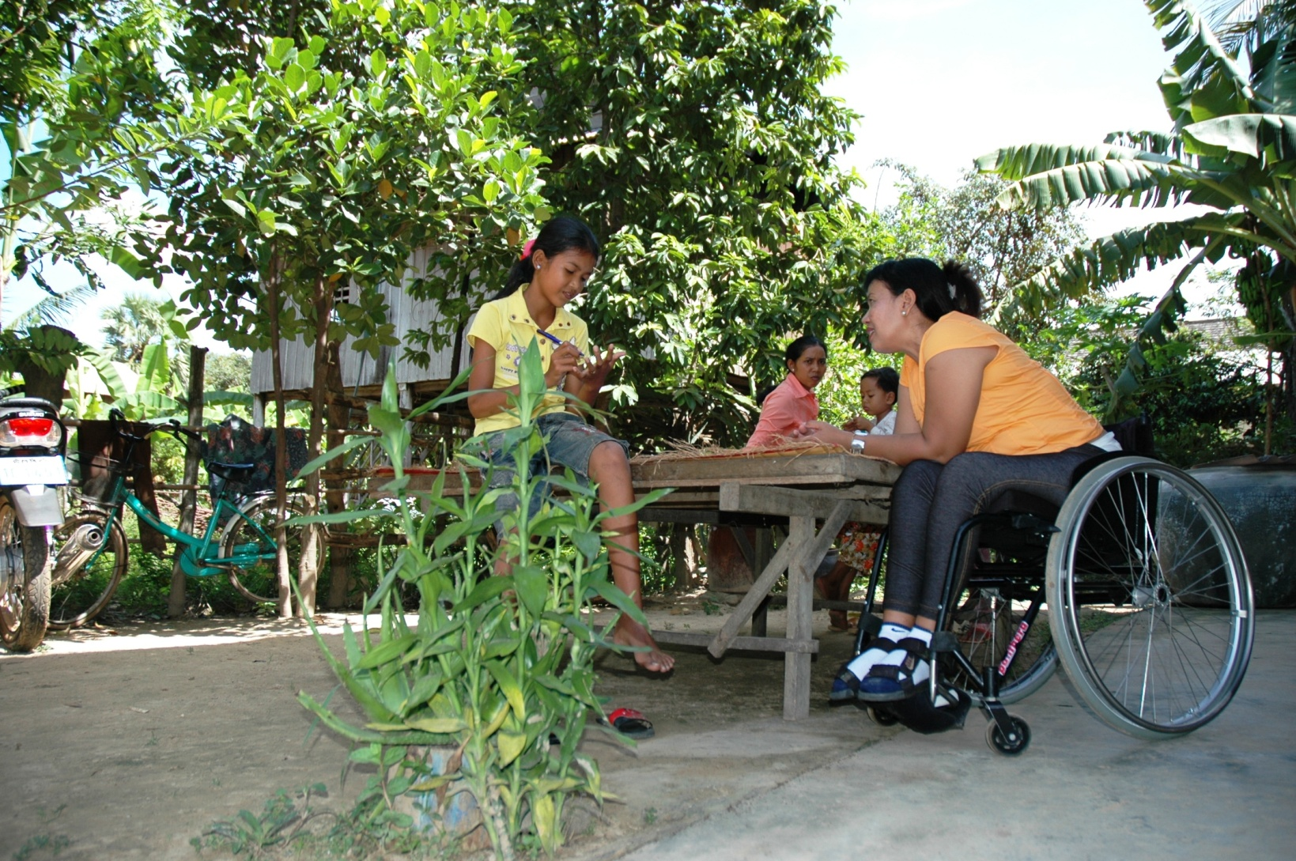
Method in Cambodia
Group 22 of non disabled children
Rural and urban
Reference group
Same method and interpreter as previous

Slide 11
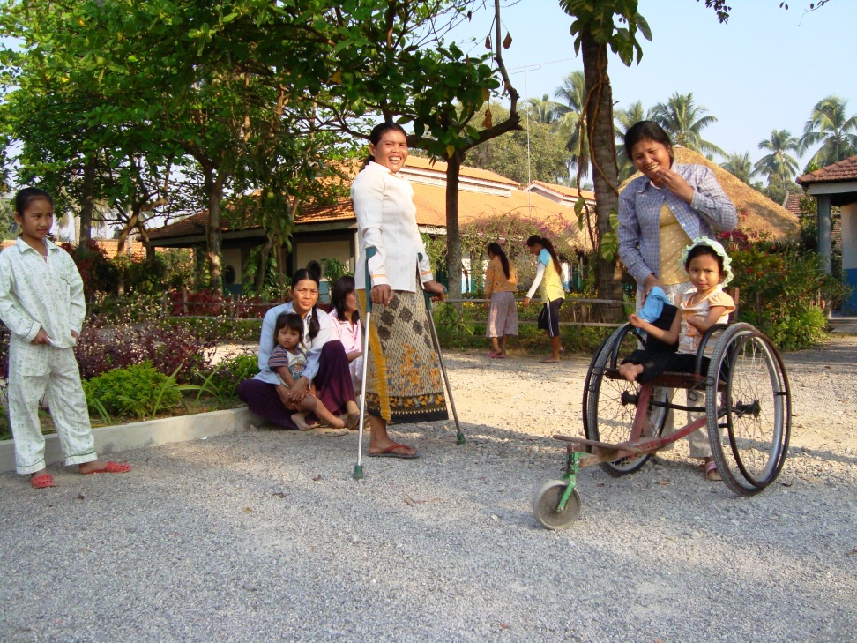
Results
Children have lower quality of life in Cambodia than in Norway
Children with prosthesis has same quality of life as non disabled children in both countries
Children with prosthesis are equally very satisfied with their prosthesis in both coutries

Slide 12
Resultater

Slide 13

Results
Prosthesis does not give reduced quality of life for children
Quality of life depends on the society where you live
Materials and components used are not important as long as comfort and function is adequate
Educated prosthetists, good fitting and follow up is most important

Slide 14
Spørsmål og diskusjon
Rune.nilsen@sophiesminde.no
Gunhild.aasen@sophiesminde.no
Forskningsmidler fra Sophies Minde

